Slide 1
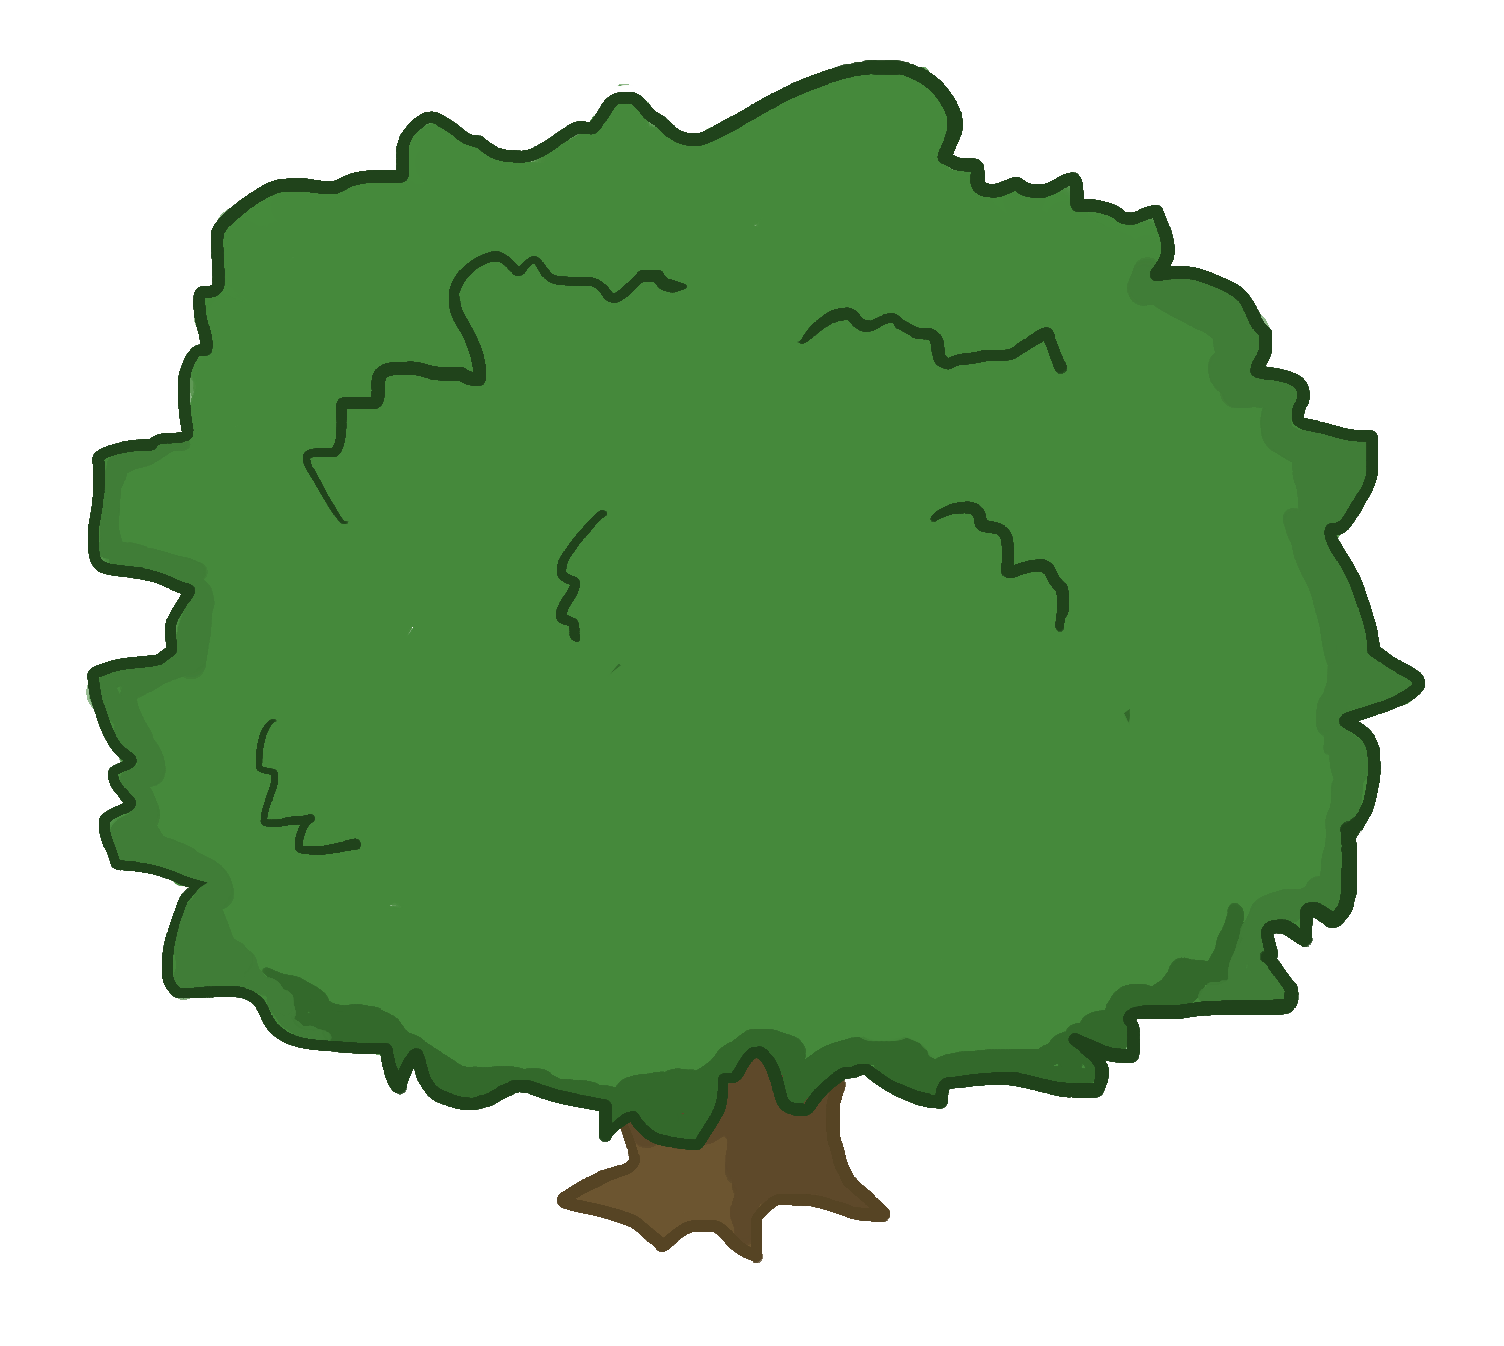
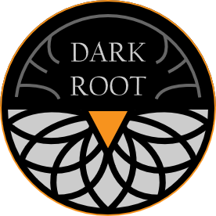
Carrot Quest The Root of Evil
STYLE GUIDE

Slide 2
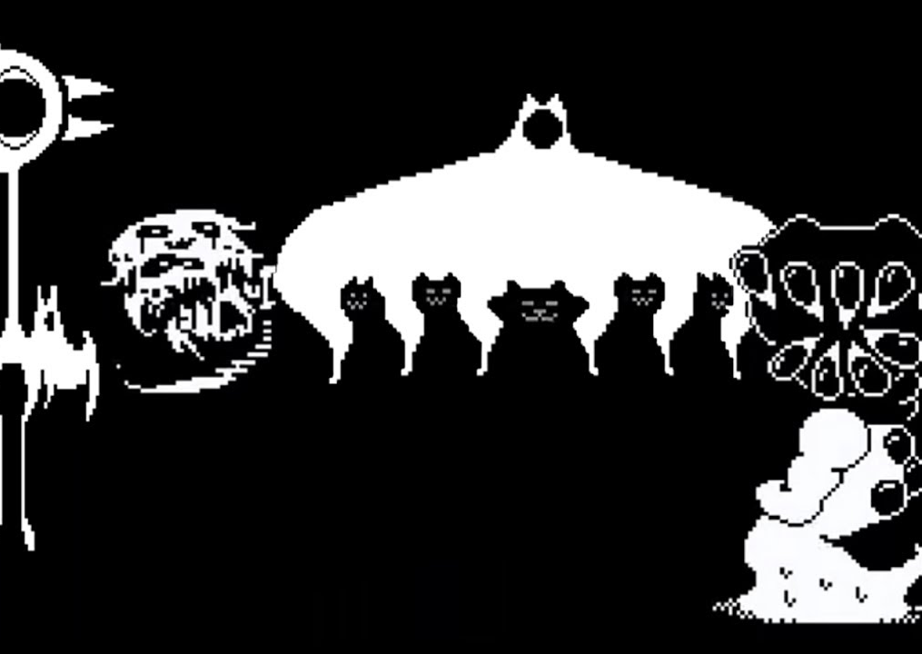
Overview
Carrot Quest is a game that’s meant to be unnerving. The cute denizens of Bunnyville are turning into grotesque creatures of the night. The cuteness is supposed to be overtly sickening to the point of almost being generic until the game’s dark roots take hold and taint the atmosphere.
The cute-ness factor of the game is merely meant to make the audience lower their guard and have them truly witness the corruption of the adorable little world.

Slide 3
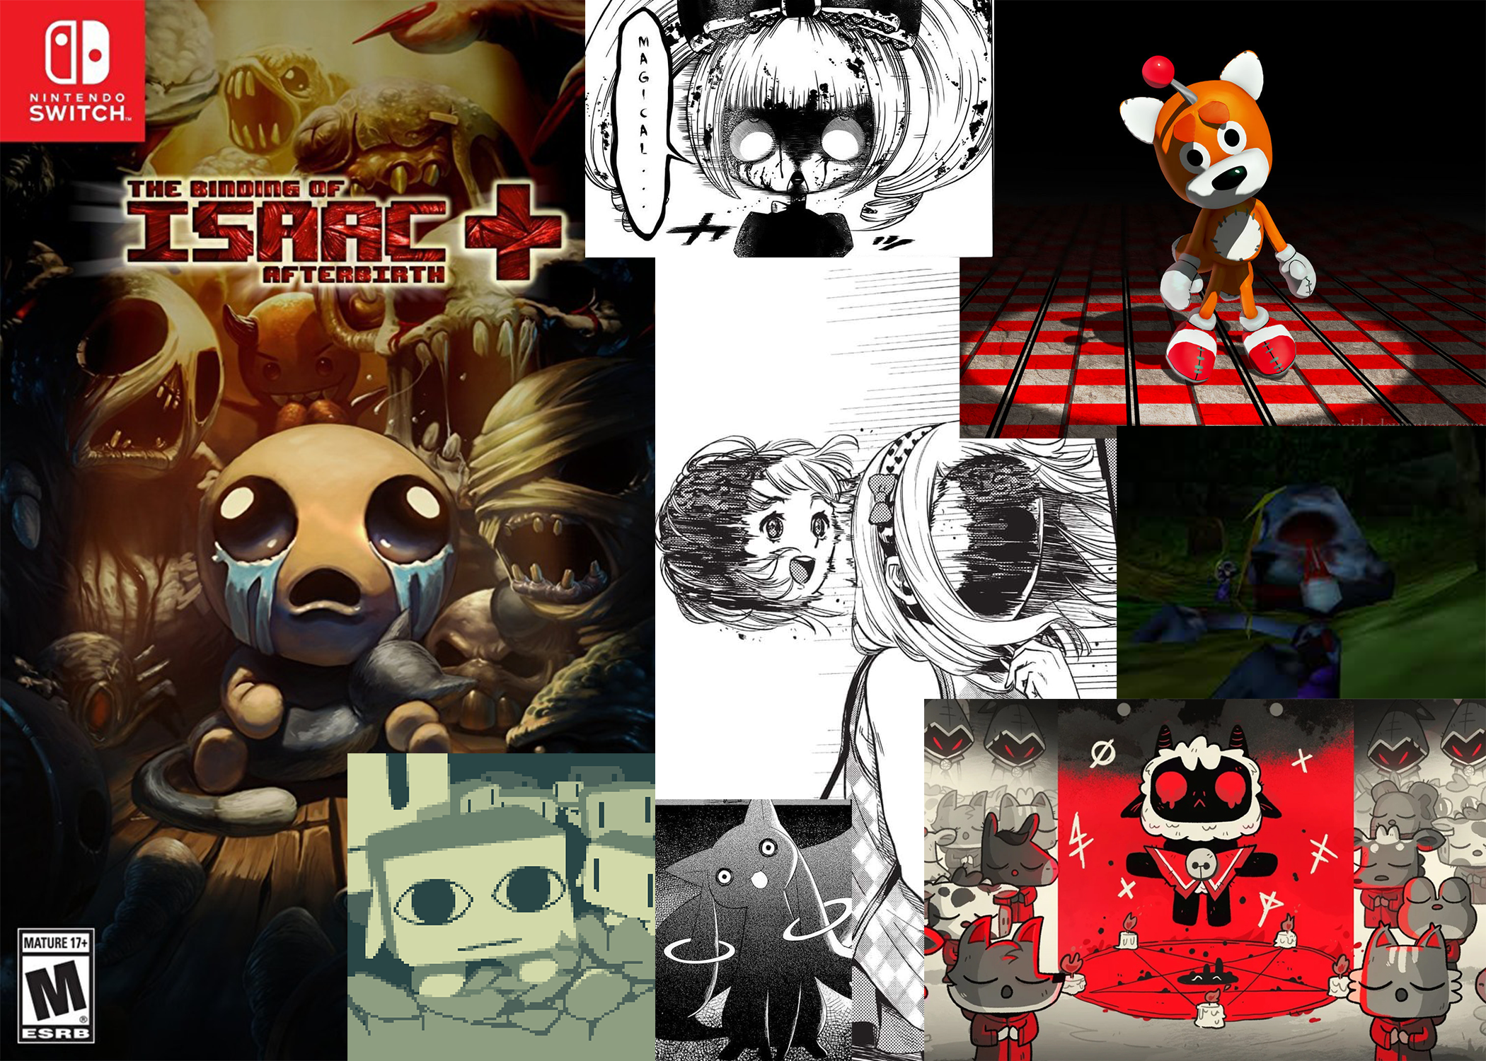
Game Feel
While the game initially has a soft and sweet feel, that is slowly corrupted. The game is meant to twist the innocence and purity of common themes such as nature and cuteness
Nature itself has been tainted with the carrot curse. The horror of the game comes from the familiar being twisted beyond recognition. The horror aspect is always supposed to be subtle. It’s close to cute, but unnerving in how close it is to creepy. It’s supposed to give you a sense of suspicion that you just can’t place.

Slide 4
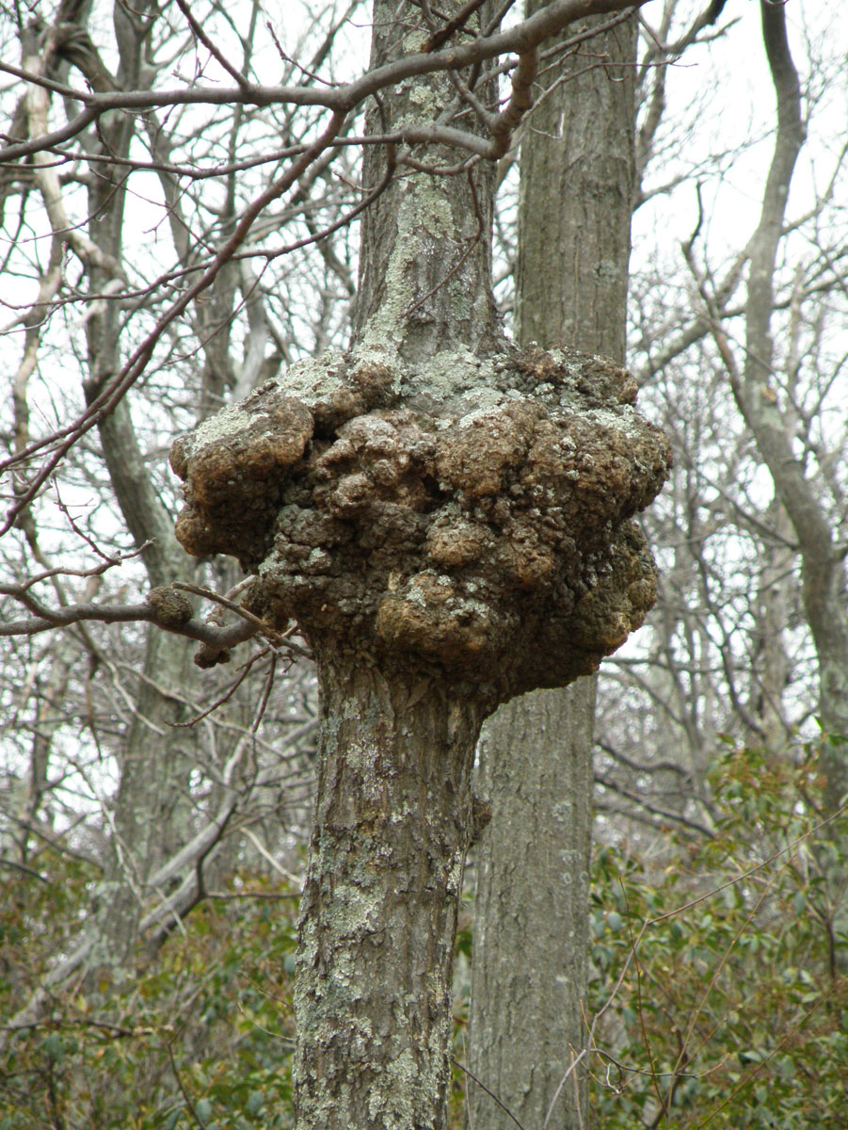
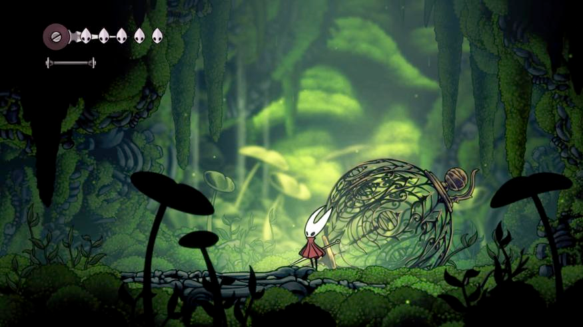
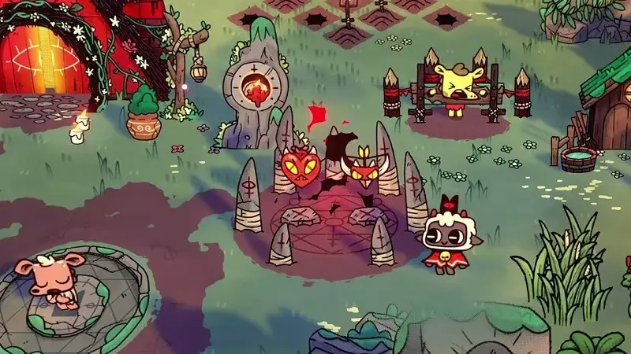
WORLD
A nature filled world with darkness and corruption lurking behind the corners. A variety of natural environments: forests, grasslands, arctic, desert, catacombs, etc.
Corruption affects the whole land, with certain areas filled to the brim. Corruption creates unsustainable growth, tumorous. Mix of decaying flesh and plant life within the environment.
Hollow Knight style lineart and cell shading, enhanced with painterly elements

Slide 5
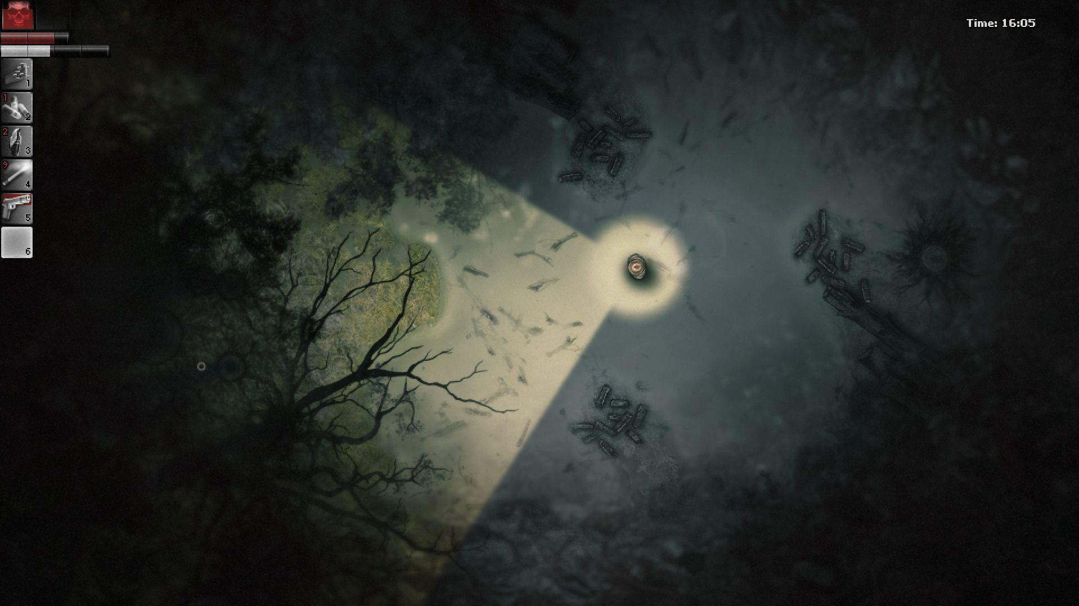
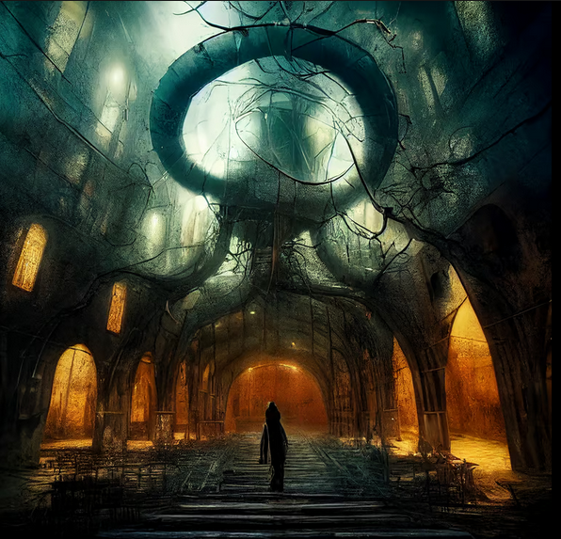
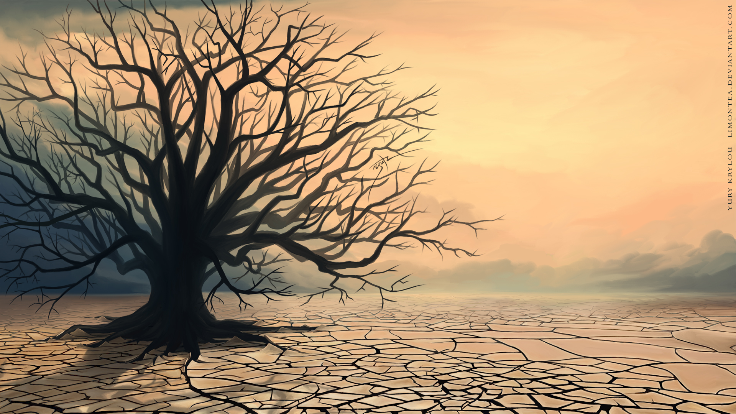
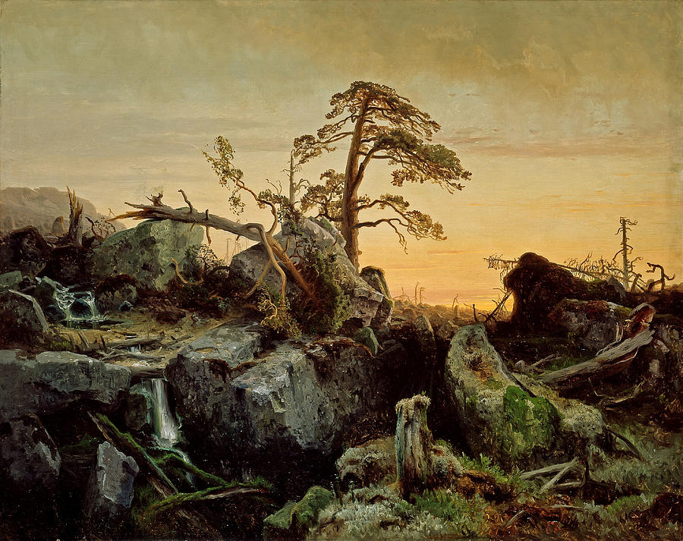
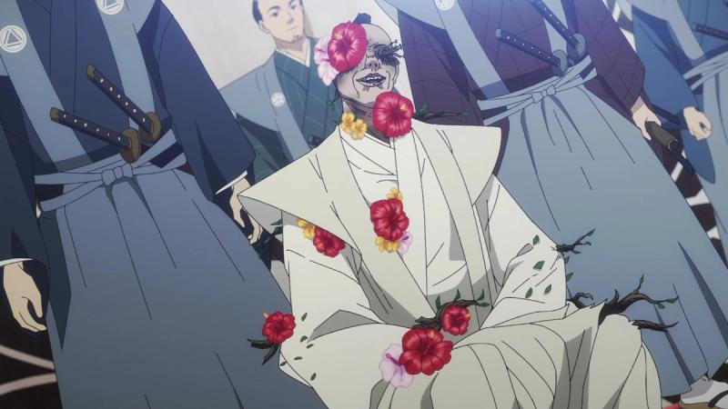
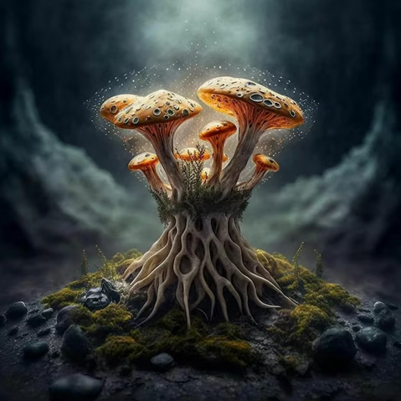
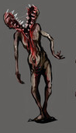
ENVIRONMENT FEEL/THEMES
Reflects the natural world, with evidence of decay and corruption.
Both darkness and color coexist. A natural environment mixed with patches of decaying nature. Like a green field, that has patches of dead weeds.
The beautiful elements of an environment combined with the horrific, to create contrast.

Slide 6
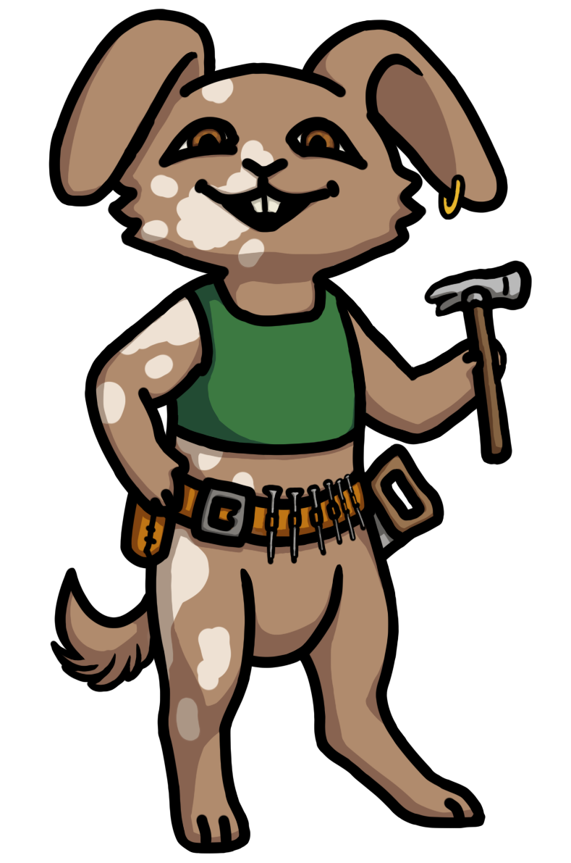
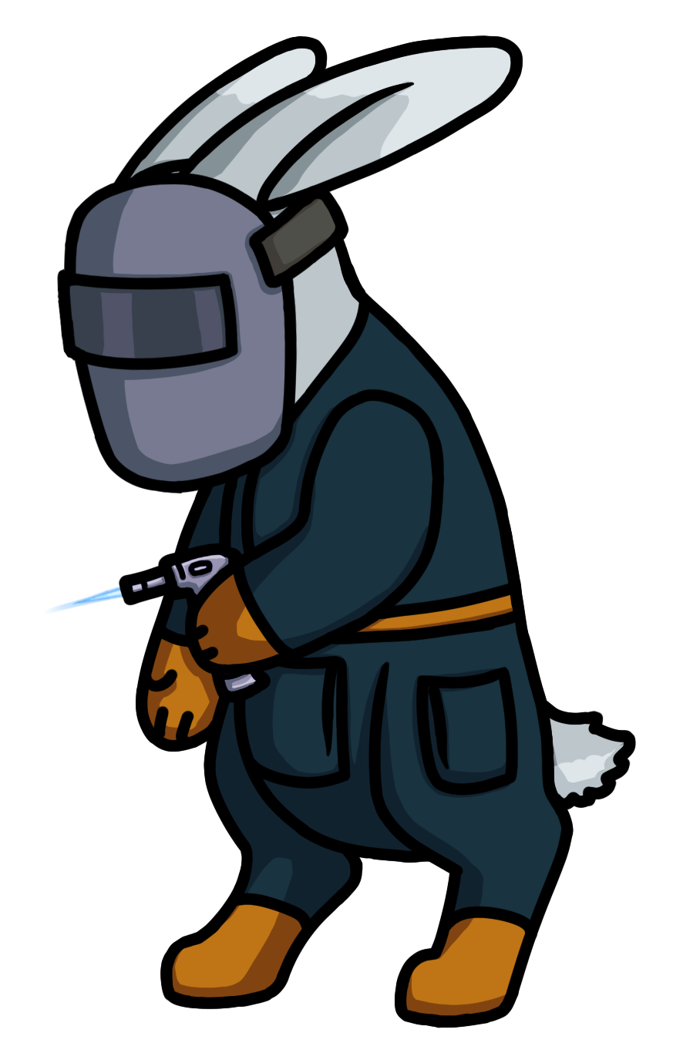
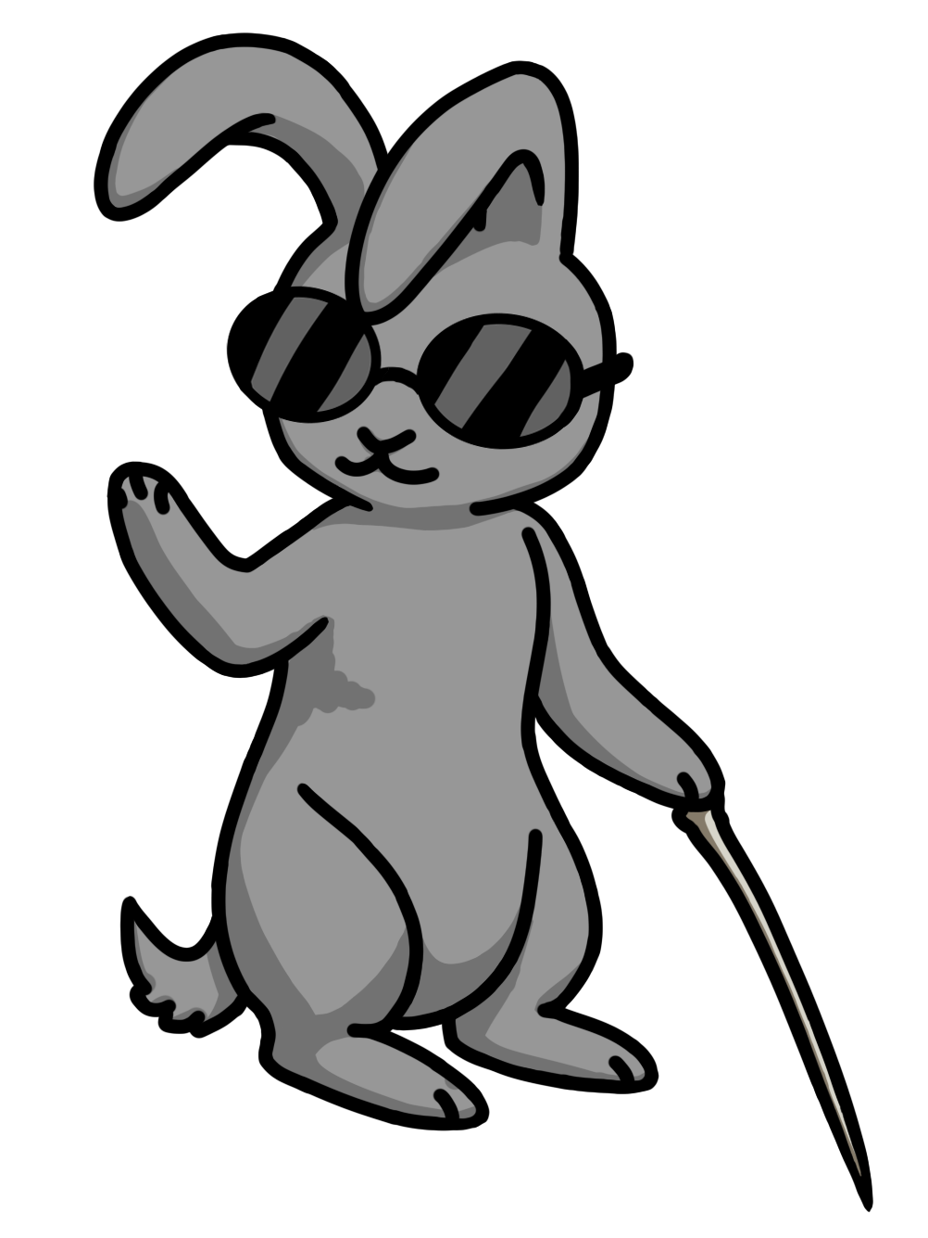

CHARACTERS
Upright, confident pose and smile shows Oakly’s cheerful and capable personality
Slightly turned away, a bit hunched. Shows Dewdrop’s more nervous personality.
Black outlines over cell shaded art
Bunnyville bunnies are friendly and look soft
A character’s idle pose should reflect their personality

Slide 7
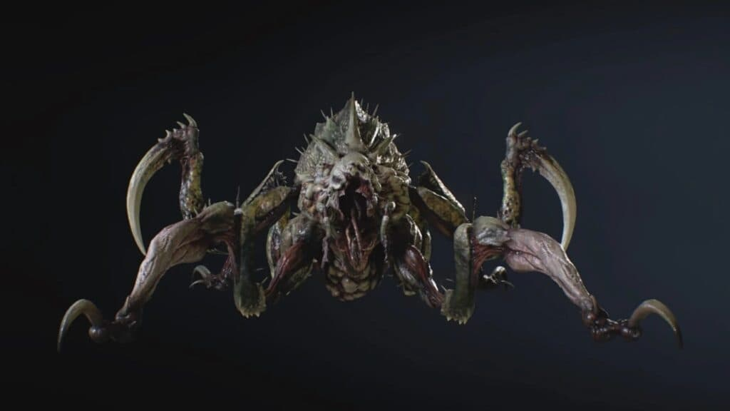
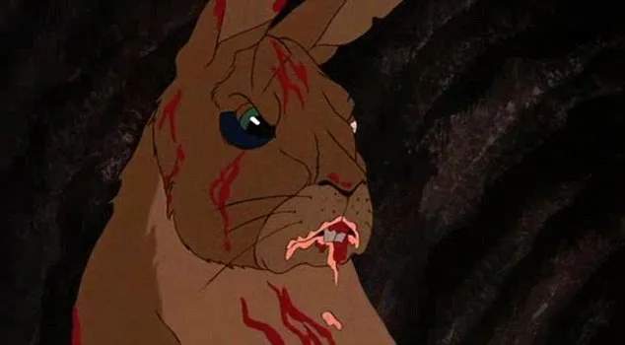
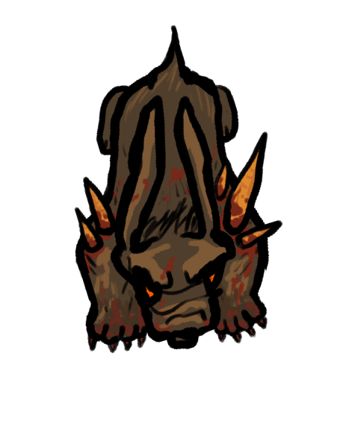
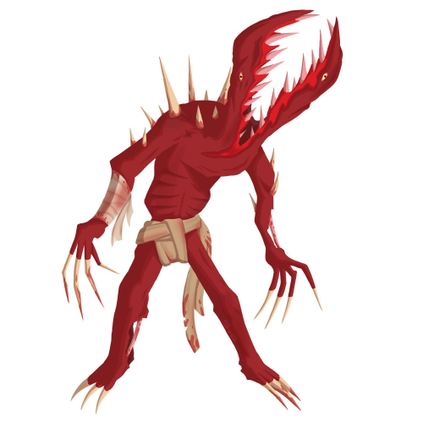
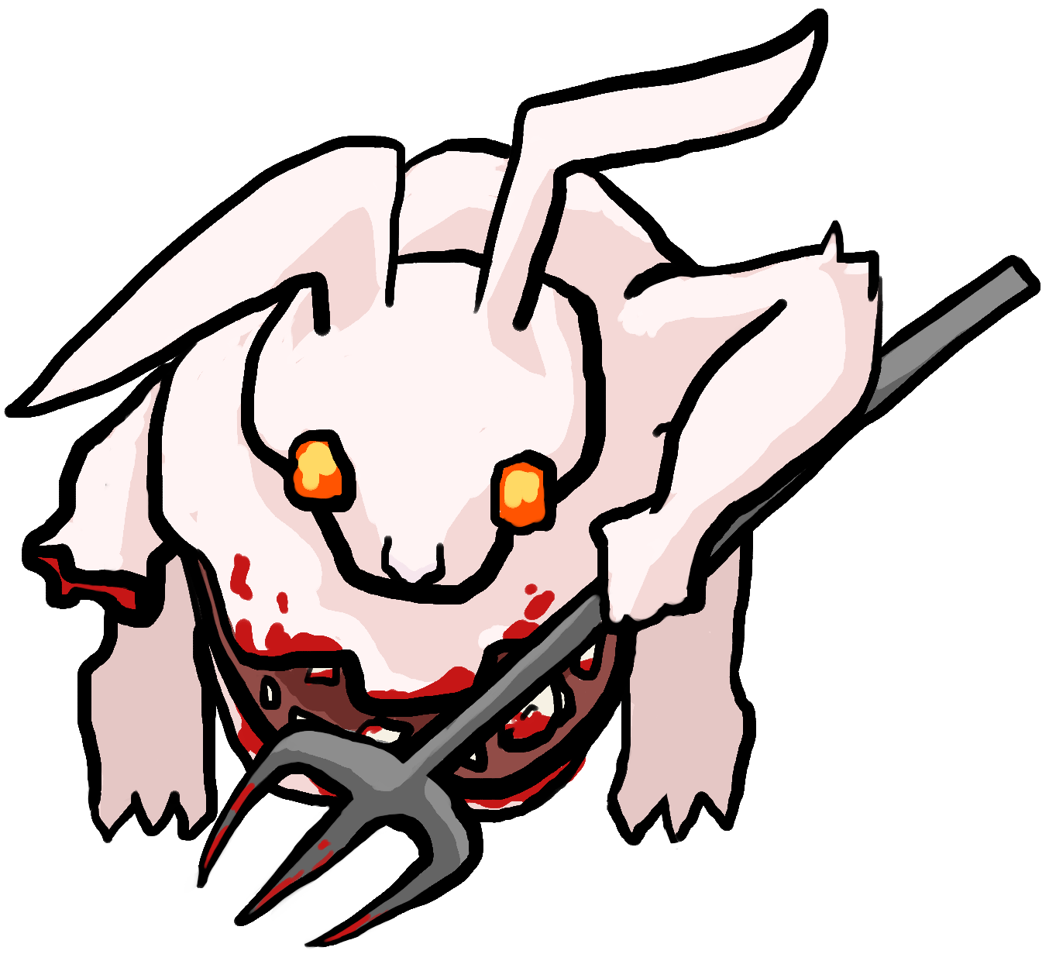
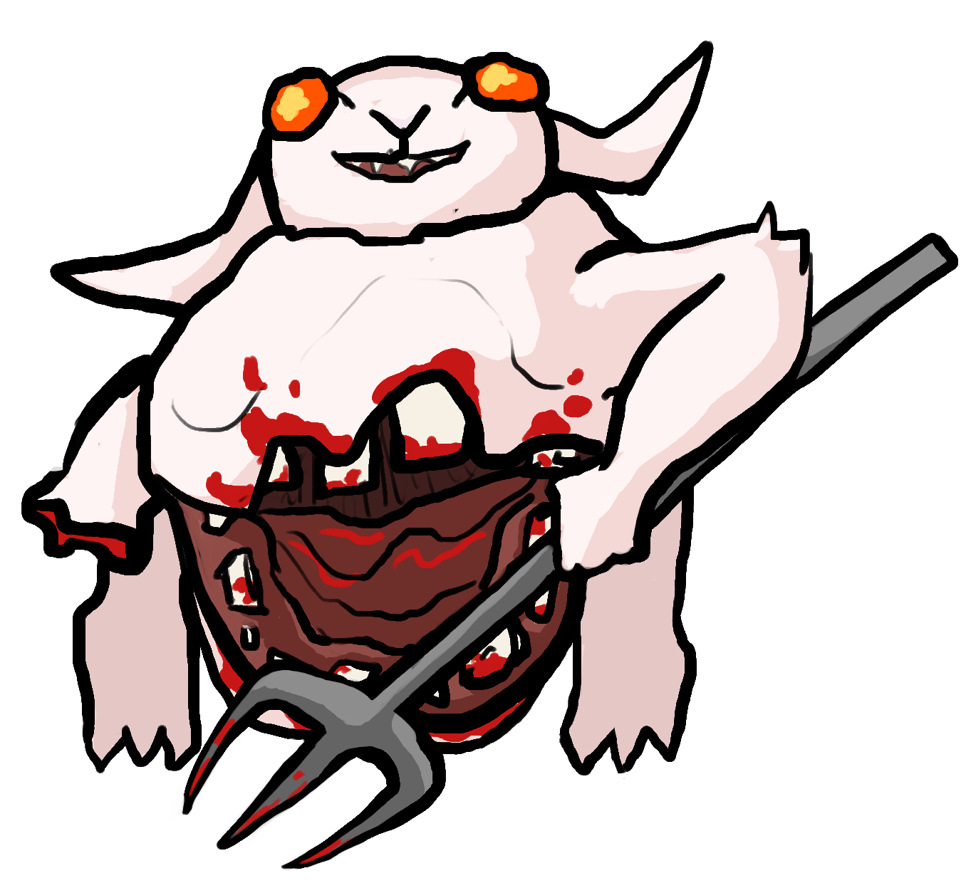
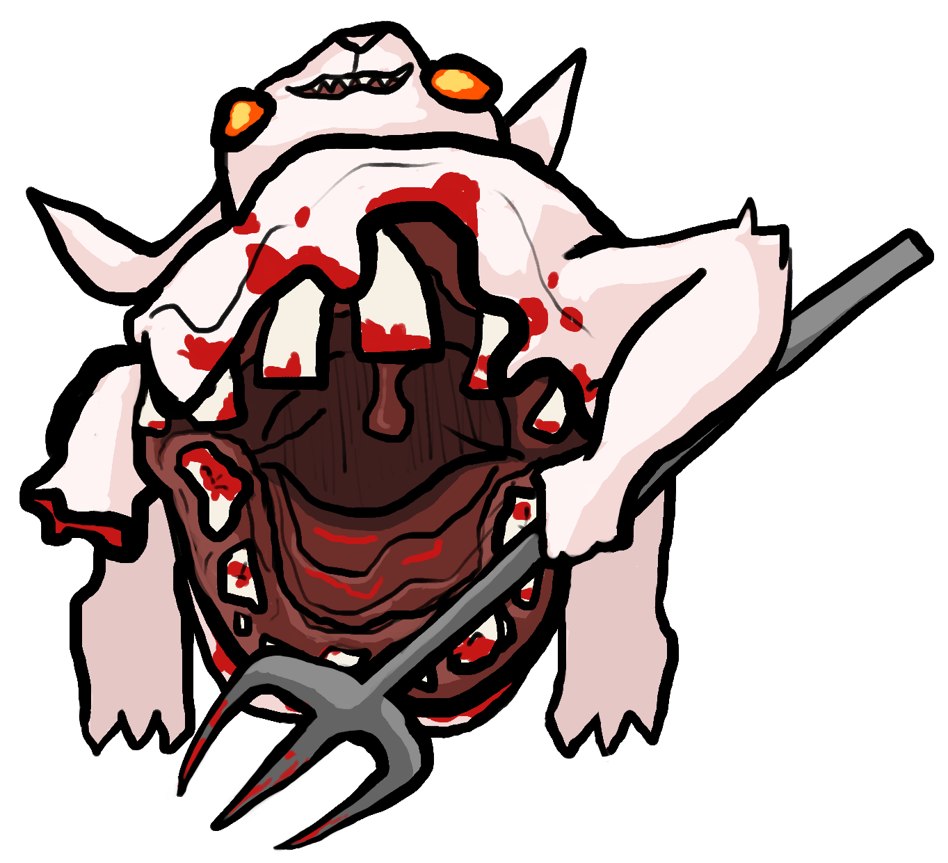
ENEMIES
Carrots growing out show the horror of the Carrot Curse
Black outlines over cell shaded art
Enemies mutated by the Carrot Curse are often zombie-like, with blood or warped bodies
Carrots often feature in the designs, as if they are growing through the cursed enemies
Enemies should have unique mutations reflecting their attack style and environment
Large mouth reflects massive melee attack style, and distinctive roar to summon allies

Slide 8
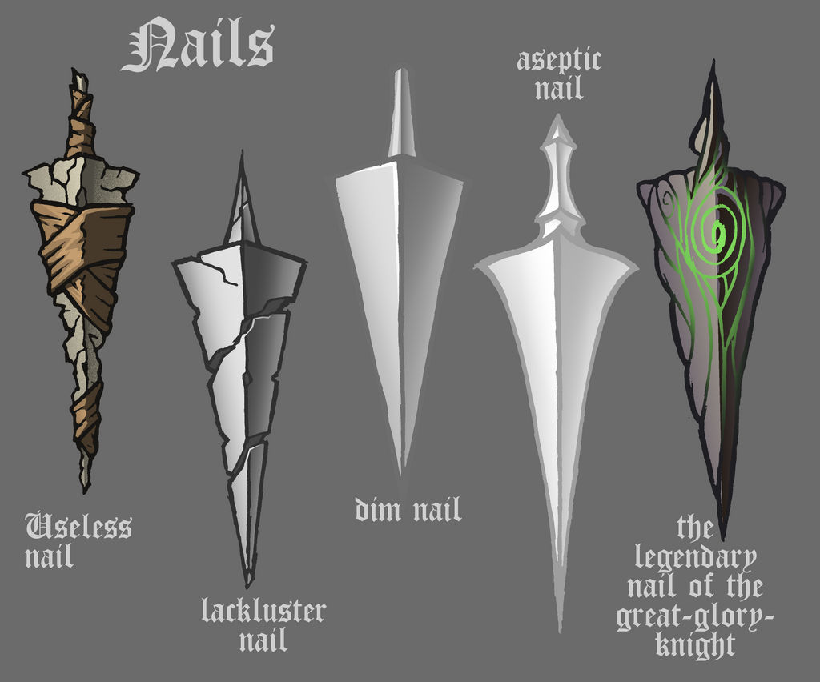


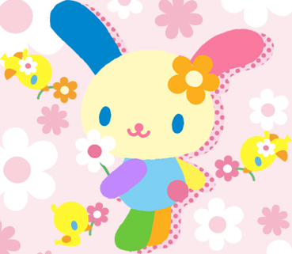
OBJECTS
Communicate the uniqueness of the item, while keeping the design simple
The currency, Carrot Seeds, is a simple rotating triangle
Other dropped items have black outlines and are cell-shaded, or have simple gradients
Items can either have a rough, sharp dreary style like the useless nail, or they can be colorful and bright like you would find in Hello Kitty. Ignore the color palette of this example and focus on style.
Powerups will not be outlined, to better enhance their unique visuals

Slide 9
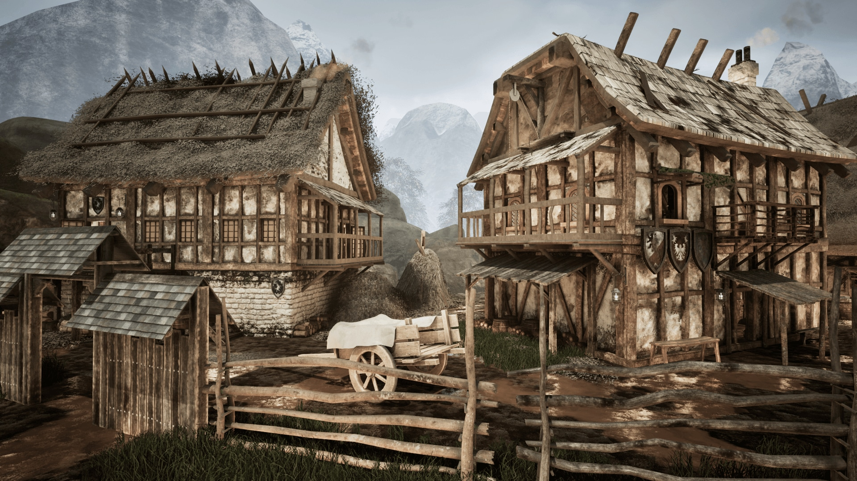
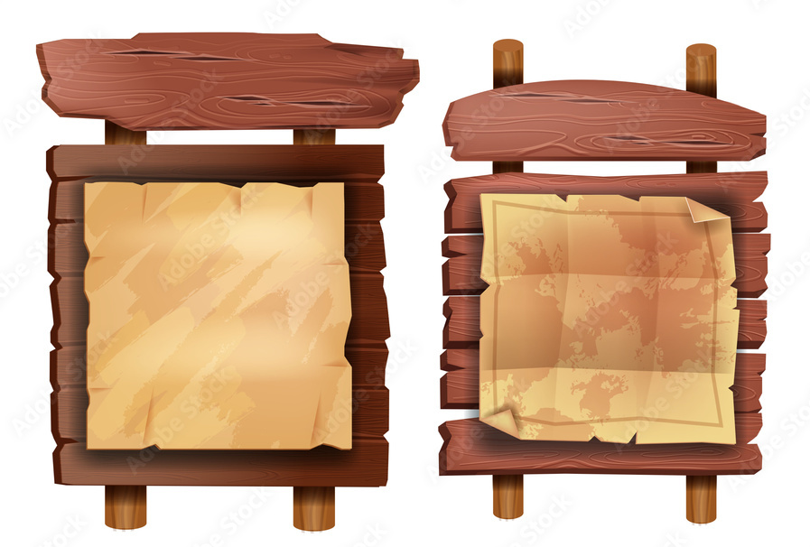
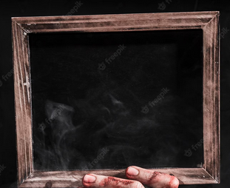
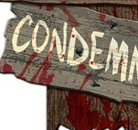
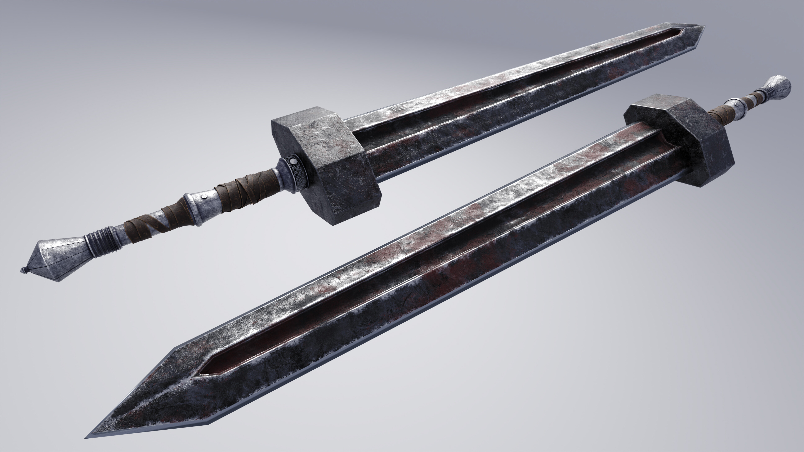
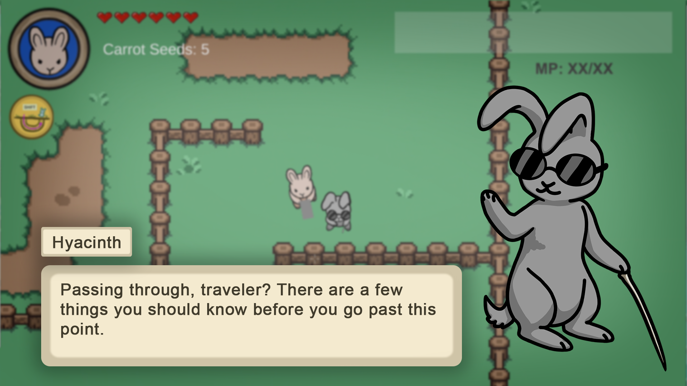
UI
Matching with the general aesthetics of the game, the UI will be outlined in black, or a dark brown
UI should feel “village rustic” with some rust and blood thrown in to show corruption. The blood will be subtle, on the corners, not overt as in the picture.

Slide 10
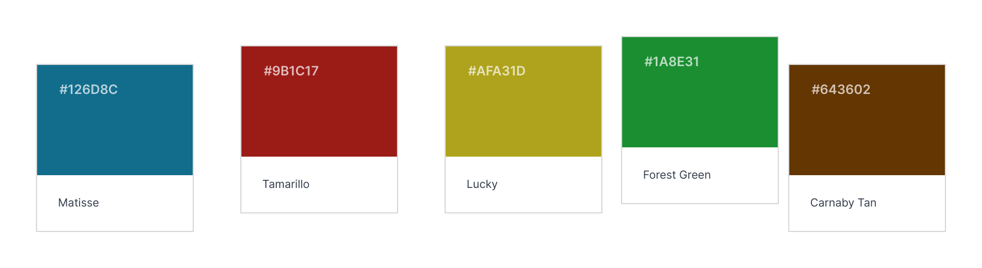
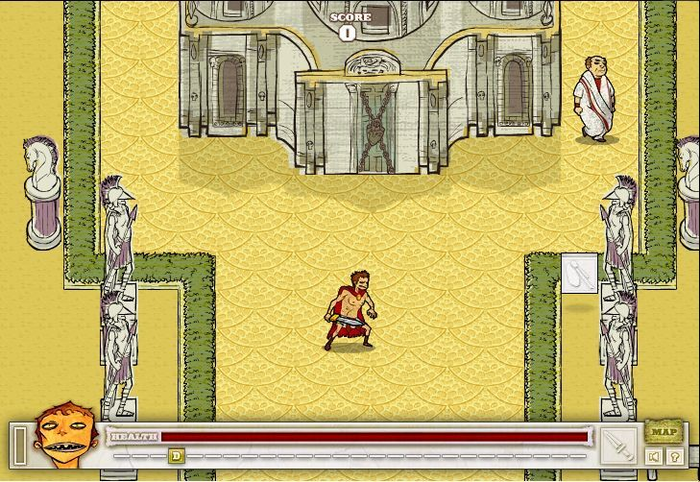
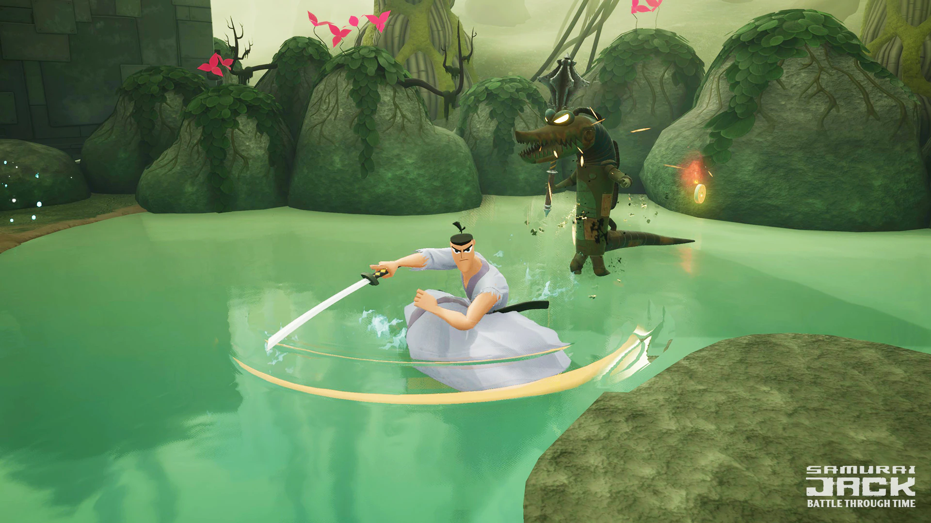
Color Palette
The color palette is similar to Adventure time, but a lot more muted color. A variety of colors, but none too cheery

